Slide 1
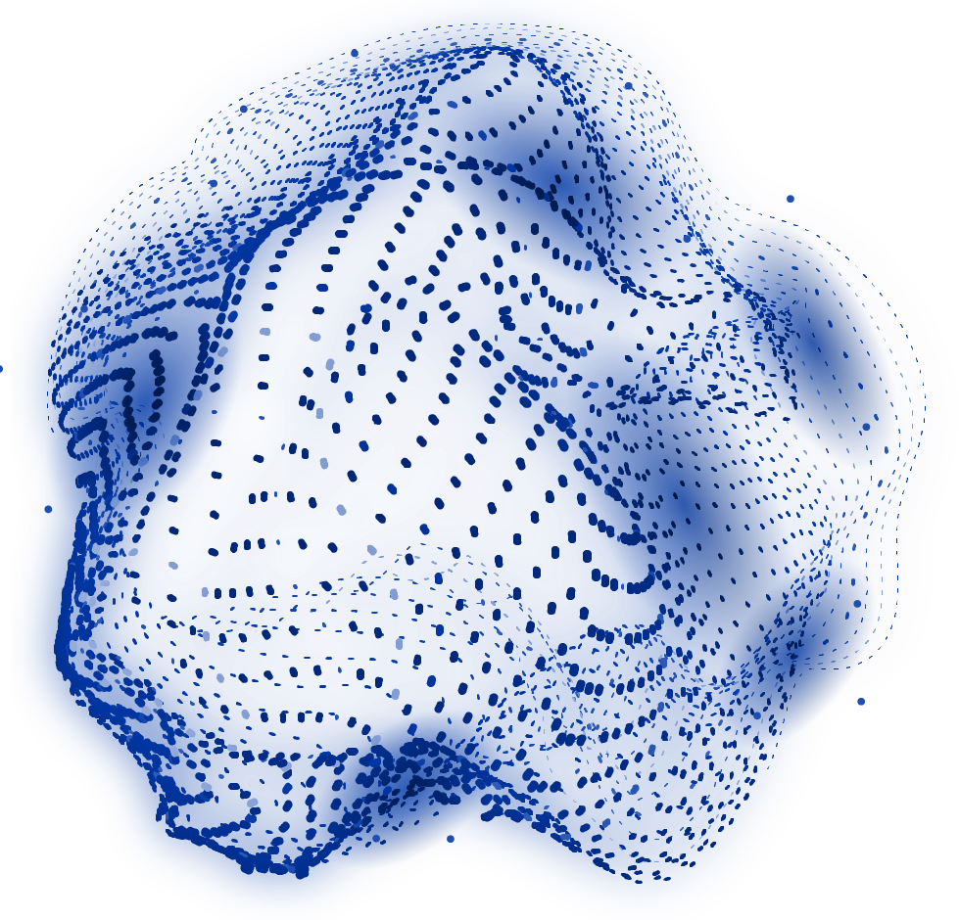
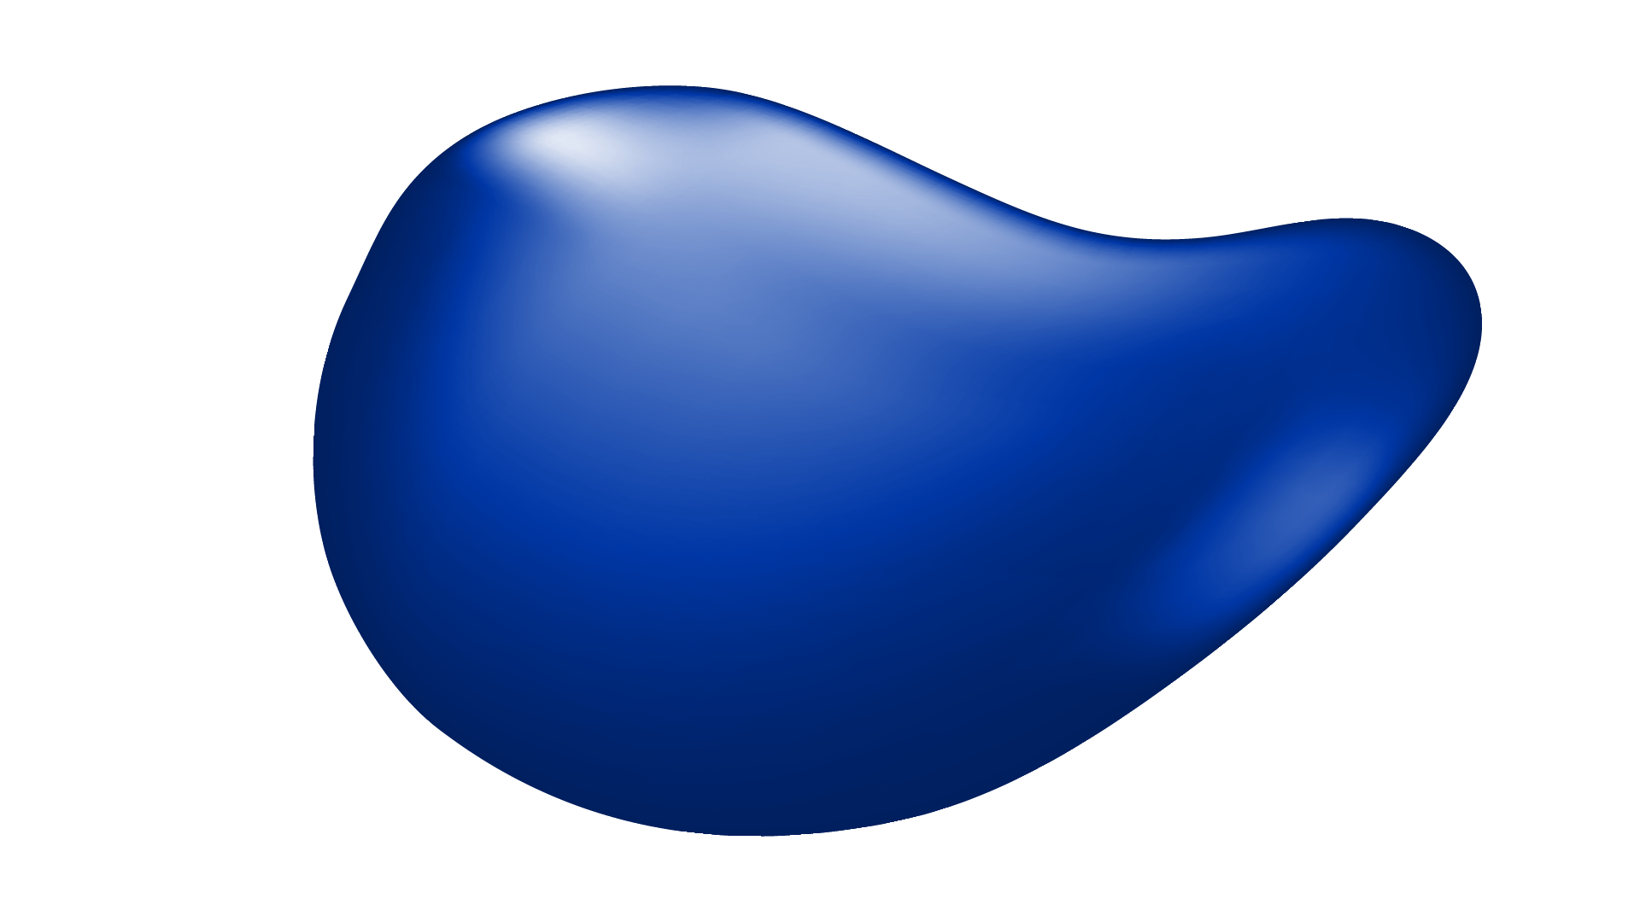
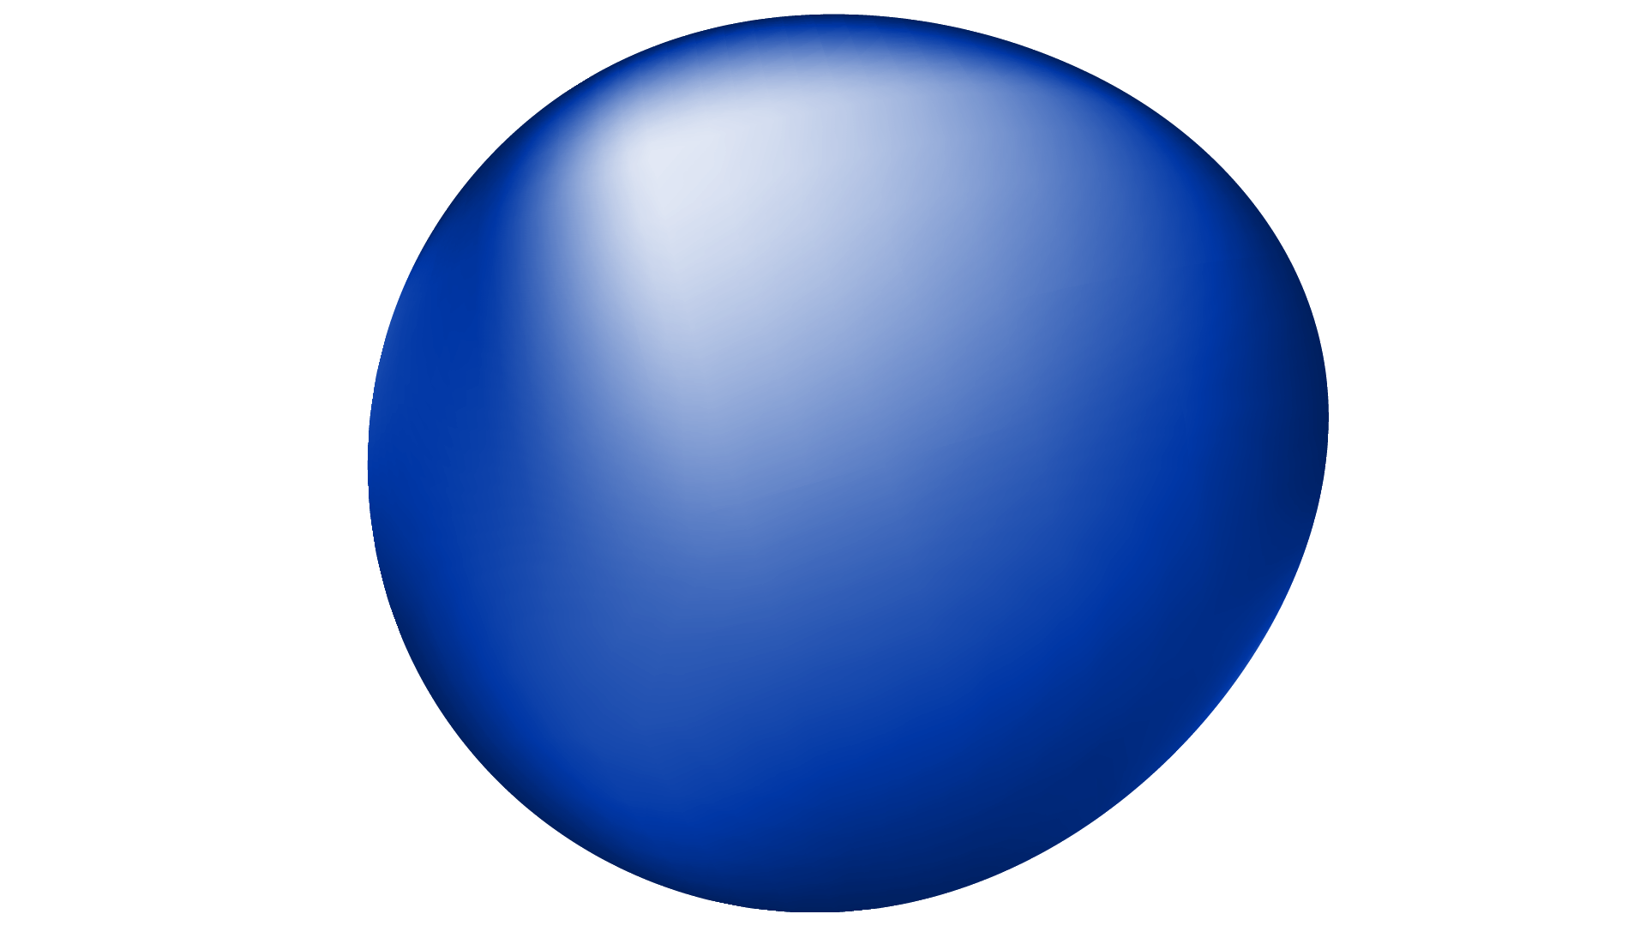
Vision-based Vibration Analysis (AI)
Using Eulerian Video Magnification (EVM)
By:
Hoor Arafa 7881
Mohamed Emadeldin 7920
Nour Hassan 8357
Mohamed Ahmed 8317

Slide 2
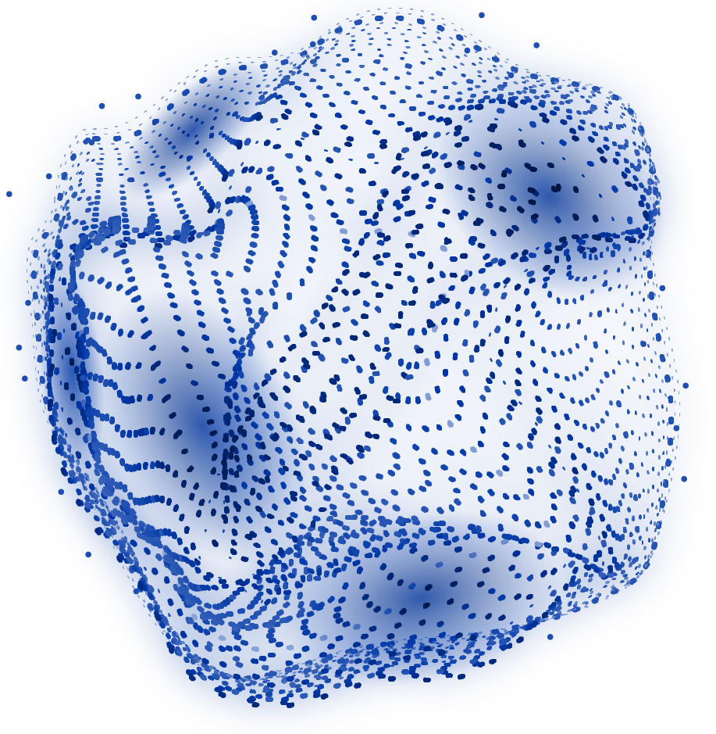
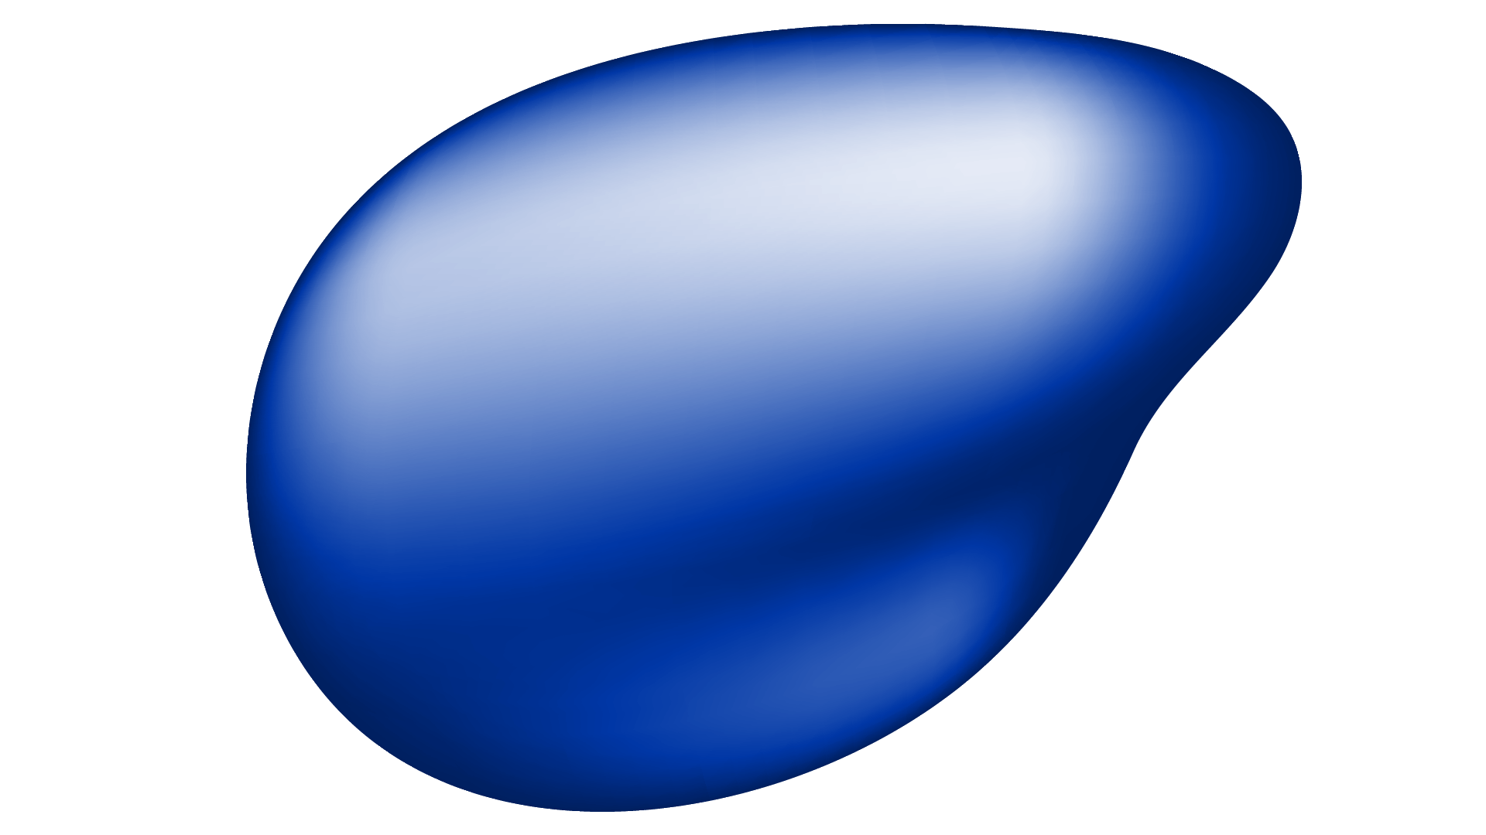
OUR PROJECT
This project aims to develop an automated system for detecting and classifying defects in industrial machines using only video recordings of their vibration patterns. By leveraging advanced computer vision techniques—especially Eulerian Video Magnification (EVM)—the system can amplify subtle machine vibrations and distinguish between healthy operation, unbalanced weight, and bearing faults.

Slide 3
Motivation & Problem Statement
WHY
WHAT
HOW
Why do we care about machine defect detection?
What is the need for early defect detection in industrial machines?
Use video-based methods for automated, low-cost defect detection
Limitations of traditional sensors (cost, setup, limited coverage)

Slide 4
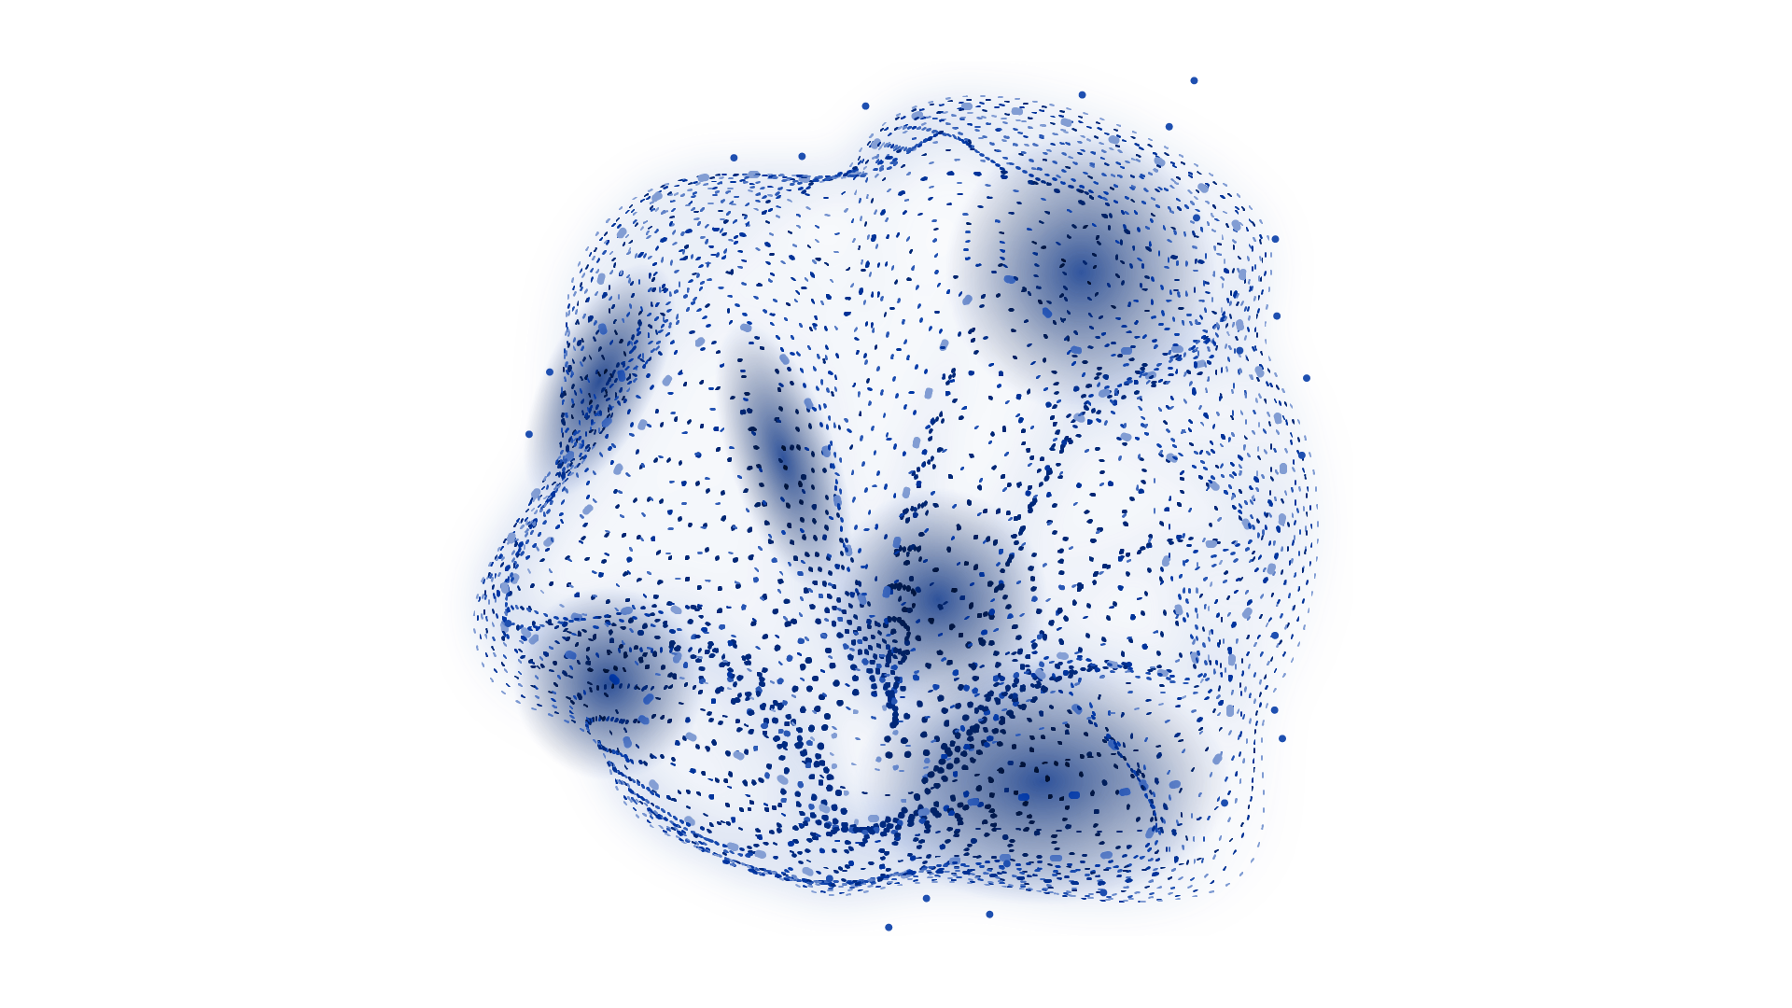
PROJECT OBJECTIVES
GOAL 1
Automatically detect & classify machine defects
GOAL 2
Focus on 3 conditions: Bearing Fault, Unbalanced Weight, Normal State
GOAL 3
Real-time or post-processing classification

Slide 5
Datasets & Video Collection
We have a small, well-organized dataset to cover the main machine conditions we want to detect. The dataset includes:
3 machine states:
Normal
Unbalanced Weight
Bearing Fault
2 camera views for each state:
Front view (at 40 cm)
Angled view
In total, there are 6 short videos (one for each combination), all recorded at 250 RPM to capture visible vibration patterns.

Slide 6
Video Preprocessing Pipeline
Motion-based ROI detection (finds active vibrating area)
Cropping & saving processed frames
STEP 2
STEP 4
STEP 1
STEP 3
Video stabilization (removes camera shake)
Histogram equalization (enhances contrast)

Slide 7
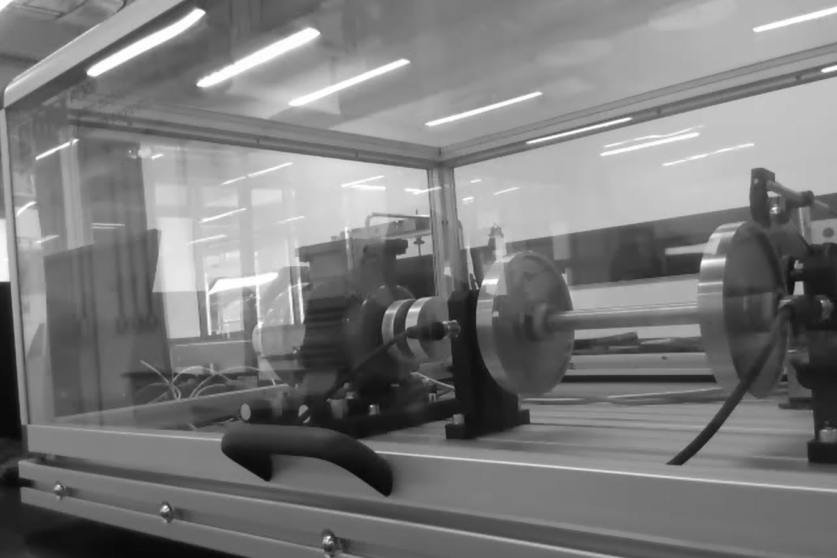
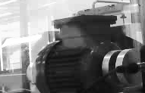
Example of ROI Detection
Original frame
ROI Detected frame
ROI detection focuses analysis on just the vibrating part of the machine, filtering out irrelevant background.

Slide 8
Synchronized Video Generation
Problem: Different videos may have varying lengths, resulting in a different number of frames.
Align all videos to same frame count & resolution
Frame interpolation to handle different lengths interpolate_frames() function
Resizing for consistency
This function blends two consecutive frames to create intermediate frames.
The number of frames in each video is adjusted to match the maximum frame count found across all videos.

Slide 9
Eulerian Video Magnification
STEP 1
Build Laplacian Pyramid for Each Frame
STEP 2
Convert Pyramid Level to Array
STEP 3
Temporal Bandpass Filtering
STEP 4
Amplification and Reconstruction
STEP 5
Save the Enhanced Video

Slide 10
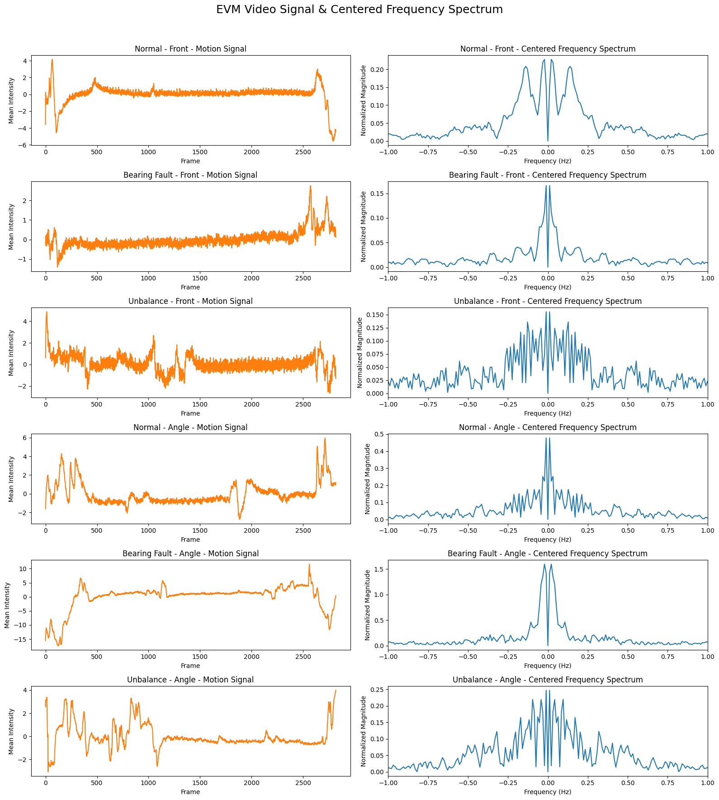
Used Parameters:
mode : laplacian
level : 5
alpha : 100
freq_range : 0.1 -2.0
attenuation : 5
lambda_cutoff :500

Slide 11
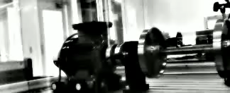
EVM OUTPUT
EVM makes subtle vibrations or changes in the original video are amplified, making them more visible as shown in the above result.

Slide 12
NEXT SEGMENTATION

Slide 13
Benefits of Video Segmentation
Granular Analysis
Overlap Option
Customizable
Breaks videos into smaller segments for more detailed analysis.
Ensures smoother transitions between segments, preventing data loss at boundaries.
Flexible segment durations and overlap ratios for tailored analysis.

Slide 14
FEATURES EXTRACTED
01
02
03
Objective: Extract specific features from each frame of the
segmented videos.
FLOW MEAN
Average movement intensity
FLOW STD
Variation in movement
FLOW MAX
Peak (strongest) movement
04
ORIENTATION MEAN
Average direction of motion
05
ORIENTATION STD
Spread in movement direction

Slide 15
FEATURES EXTRACTED
06
07
TEMPORAL GRAD MEAN
Average change in motion over time
Variation in change over time
TEMPORAL GRAD STD
08
TEMPORAL GRAD MAX
Maximum sudden change
09
DOMINANT FREQ
Most common vibration frequency (Fourier-based)
10
FLOW ENTROPY
Randomness in motion flow
11
MOTION CONSISTENCY
Stability ratio (flow_std / flow_mean)

Slide 16
Creating Duration-Based CSV Files for Each Group
Key Operations:
Scan for Segmented Data: The script searches through the segmented data folders for each class, extracting CSV files and grouping them based on the duration (5s, 10s, 15s) and overlap condition (overlap or no overlap).
Metadata Extraction: For each CSV file, metadata is added, including the class name, file name, duration, and overlap status.
Concatenate Data: For each group (based on duration and overlap), CSV files are read, metadata is appended, and the data is concatenated into a single Data Frame.

Slide 17
Model Training and Evaluation
01
02
03
DATA PREPROCESSING
For each group, the corresponding CSV is loaded.
Missing columns are checked, and if necessary, columns like 'class' or 'view' are encoded.
Data Augmentation and Feature Normalization
Numerical features are normalized using StandardScaler.
Data augmentation is applied to introduce noise to the features, enhancing model robustness.
A neural network is built using Keras, with layers for dense connections, dropout, batch normalization, and L1/L2 regularization.
MODEL BUILDING

Slide 18
Model Training and Evaluation
04
05
Data Splitting
The data is split into training, validation, and test sets using an 85/15 split, followed by a 70/15 split for training and validation.
Model Training
The model is trained using the Adam optimizer with a lower initial learning rate and early stopping to prevent overfitting.
ReduceLROnPlateau is used to adjust the
learning rate dynamically.
06
Class Weighting
Class weights are computed to address any class imbalance, ensuring that the model does not favor the majority class.
07
Evaluation and Visualization
The model is evaluated on the test set, and performance metrics such as accuracy and loss are stored for each group.
Plots for training and validation loss, as well as accuracy, are displayed to visualize the model’s learning process.

Slide 19
NEXT THE MODEL

Slide 20
Model Architecture
Dense, 64 ReLU
L2 = 0.01
Batch
Normalization
Dense, 32 ReLU
L2 = 0.05
Batch
Normalization
Dense, 16 ReLU
L2 = 0.005
Dropout
Dense,
SOFTMAX
CLASSIFICATION
INPUT
FEATURES

Slide 21
Training Setup
Loss Function: CrossEntropyLoss with label smoothing and class weights to handle imbalanced data.
Optimizer: Adam with L2 regularization (weight decay) for generalization.
Scheduler: Step learning rate scheduler to reduce the learning rate periodically and stabilize learning.
Early Stopping: Implemented to stop training if the validation loss doesn't improve after 40 consecutive epochs.

Slide 22
Dataset Details
The dataset includes 8454 video frames, extracted from synchronized recordings of different machine states.
The frames were split into training, validation, and test sets.
Data augmentation techniques were applied to increase robustness and reduce overfitting.

Slide 23
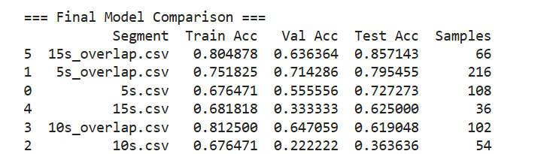
Performance Summary
The best overall test accuracy (85.71%) was achieved using the 15s_overlap.csv segment, despite moderate validation accuracy (63.6%). The 5s_overlap.csv provided the most consistent performance across train, validation, and test sets with the largest number of samples. Longer segments without overlap (10s.csv, 15s.csv) showed weaker generalization, especially on validation data. Overlapping windows generally performed better, suggesting that segment overlap improves model robustness.

Slide 24
QUESTIONS

